Slide 1
Including the TNC Mode in Mode Choice Models Estimated Using Smartphone-Based Household Travel Survey Data
JUNE 3, 2019, TRB PLANNING APPLICATIONS CONFERENCE
Mark Bradley, RSG | Yanmei Ou, SACOG | Dan Tischler, SFCTA

Slide 2
Acknowledgements and presentation outline
Christopher Coy and Elizabeth Greene of RSG led the survey efforts.
Thanks to our client sponsors for their vision and financial support:
Shengyi Gao (SACOG), Joe Castiglione (SFCTA) and Shimon Israel (MTC).
Caltrans provided financial support for further data collection
Outline
Overview of the Sacramento and Bay Area surveys
TNC mode share descriptive analysis
Estimation results for two tour-level mode choice models
Conclusions

Slide 3
Overview of the Sacramento and Bay Area Surveys

Slide 4
TNC use is growing rapidly, but there is limited data available to inform planning, modeling, and policy-making responses
These surveys both provide high quality data for analysis:
  Using rigorous methods (i.e., probability sampling)
  Using innovative methods (i.e., 7-day smartphone-based diary)
  Collecting a sizable number of TNC trips (geographic oversampling)
  Capturing comprehensive travel behavior data (person’s entire travel)
Notes:
Estimation of model components
Auto ownership? (Test re-estimation with new TNC-inclusive accessibilities?)
Tour mode
Trip mode
Development of expanded tour and trip mode targets for calibration
TNC Tours: totals & shares
TNC Trips: totals & shares
Development of profiles for calibration
TNC users (e.g., demographics)
TNC trips (e.g., trip wait times)

Slide 5
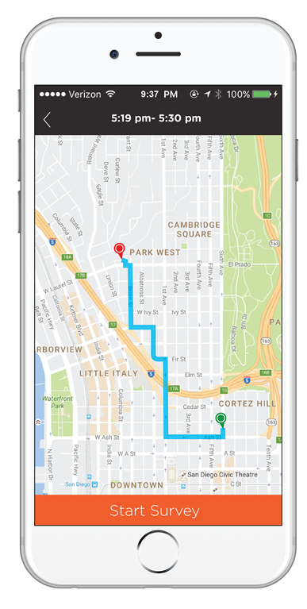
The questionnaire captures comprehensive household, demographic, and travel data over the course of the week
Participants see 3 types of surveys in rMove
Signup survey upon activating the app (basic HH composition)
Trip surveys after each trip
e.g., “How did you travel to this destination?”
Daily ‘end-of-day’ surveys, covering a unique topic each day
  Topics include: employment, school, typical travel, land use,
  personal vehicle, and more.
Notes:
After participants sign up, their travel week starts the next day and runs for 7 consecutive days.
Spreading out the survey questions across the week helps reduce burden.

Slide 6
Summary Statistics from Surveys
SURVEY | Sacramento Region (SACOG) 2018 | SF Bay Area (MTC/SFCTA) 2018-19
Region size | 6 counties, 2.3 M people | 9 counties, 7.3 M people
Sample type | All household members | Adults w/ smartphones
Sample size | 6,800 adults in 4,000 HH (75% used smartphone) | 5,000 adults (100% used smartphone)
Travel days | 35,000 | 33,000
Trip records | 150,000 (96% from smartphone) | 150,000 (100% from smartphone)
TNC trip records | 900 (0.6% of trips, 0.4% when weighted) | 5,000 (3.4% of trips, will be 1-2% weighted)

Slide 7
TNC Mode Share Descriptive Analysis

Slide 8
Sacramento and Bay Area TNC Mode
Shares Along Various Dimensions
This analysis only includes trips by smartphone-owning adults
The Bay Area data is a partial sample, including about two-thirds of the final sample. (Data collection was just completed in late May.)
Data is unweighted. (Final data sets have been/will be expanded and weighted to the full population.)
Notes:
“According to recent studies, between 43% and 61% of TNC trips substitute for transit, walk, or bike travel or would not have been made at all” (source: https://www.sfcta.org/sites/default/files/2019-05/TNCs_Congestion_Report_181015_Finals.pdf, page 12)

Slide 9
TNC mode share is highest in evenings and nights for all days of the week
SACRAMENTO
BAY AREA

Slide 10
TNC mode share is highest among the younger age groups
SACRAMENTO
BAY AREA

Slide 11
TNC mode share varies dramatically by car ownership level
SACRAMENTO
BAY AREA

Slide 12
TNC mode share varies less by income than by age or car ownership, and in opposite directions in the two regions
SACRAMENTO
BAY AREA

Slide 13
TNC mode share is highest for work-related, social/recreation and meal trips, and lowest for escorting and shopping trips
SACRAMENTO
BAY AREA

Slide 14
Tour Mode Choice Models Including TNC Mode

Slide 15
Modeling method
Tour-level mode choice models estimated on the Sacramento data using the DaySim software and SACSIM inputs
Data is for weekdays only (Mon-Fri)
Data is unweighted. (Weighted data used later for model calibration.)
Separate models presented here for home-based work tours and home-based non-work/school tours

Slide 16
Model estimation sample sizes
HB Non-Work/School Tours HB Work Tours

Slide 17
Direction and significance of TNC utility variables
VARIABLE | WORK TOURS | OTHER TOURS
Mode-specific constant | - - - | - - -
In-vehicle time | - - - | - - -
Fare cost | - - - | - - -
No cars in HH | + + + | + +
Car competition in HH | +
Income under $25,000 | + + | +
Income over $100,000 |  | - - -
Tour main purpose is shopping |  | - - -
Departure time is after 9 PM |  | + +
Transit stop density near home | - -
Land use density near home | + + + | + +
Land use density near destination | + + + | +

Slide 18
Additional comments on model results
Age variables were tested but were not significant in either model
Mode nesting structures were tested nesting TNC with car, transit or walk/bike, but best results were obtained leaving TNC in a separate nest.
WALK
CAR SOV
TRANSIT
BIKE
CAR HOV
TNC

Slide 19
Conclusions

Slide 20
Conclusions
Even though the overall TNC mode shares in the two surveys are very different, the patterns in mode shares along key dimensions are very similar (except for income).
Multi-day smartphone data collection and geographic oversampling allow collection of enough TNC trips to estimate several significant variables for TNC in mode choice models, even in a region where the actual TNC mode share is still quite low.
The Bay Area data with about 5,000 TNC trips will provide rich data for mode choice model estimation.

Slide 21
Mark Bradley
Senior Director
Mark.Bradley@rsginc.com

Slide 22
Backup

Slide 23
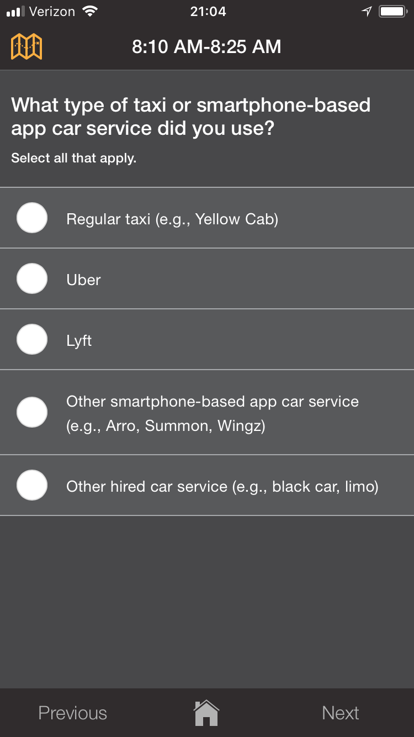
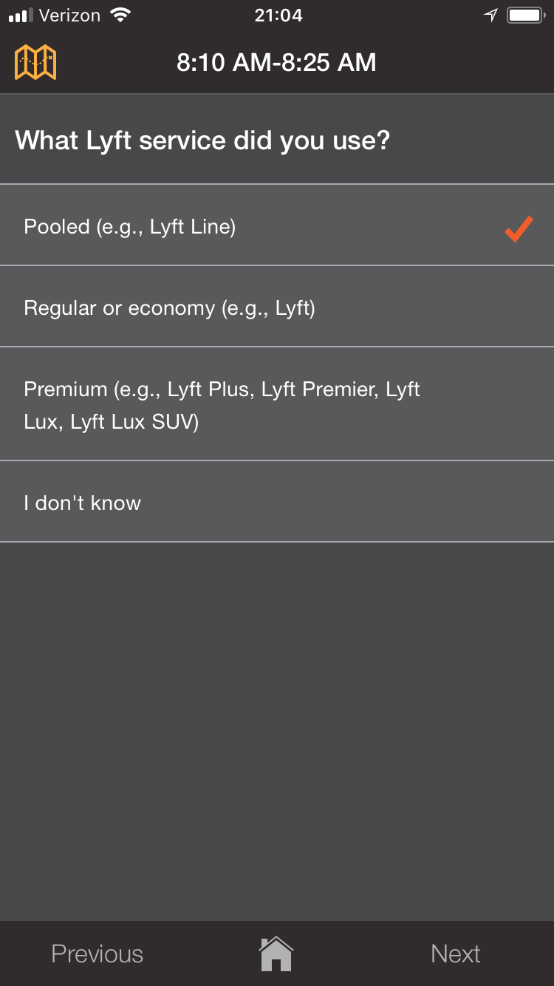
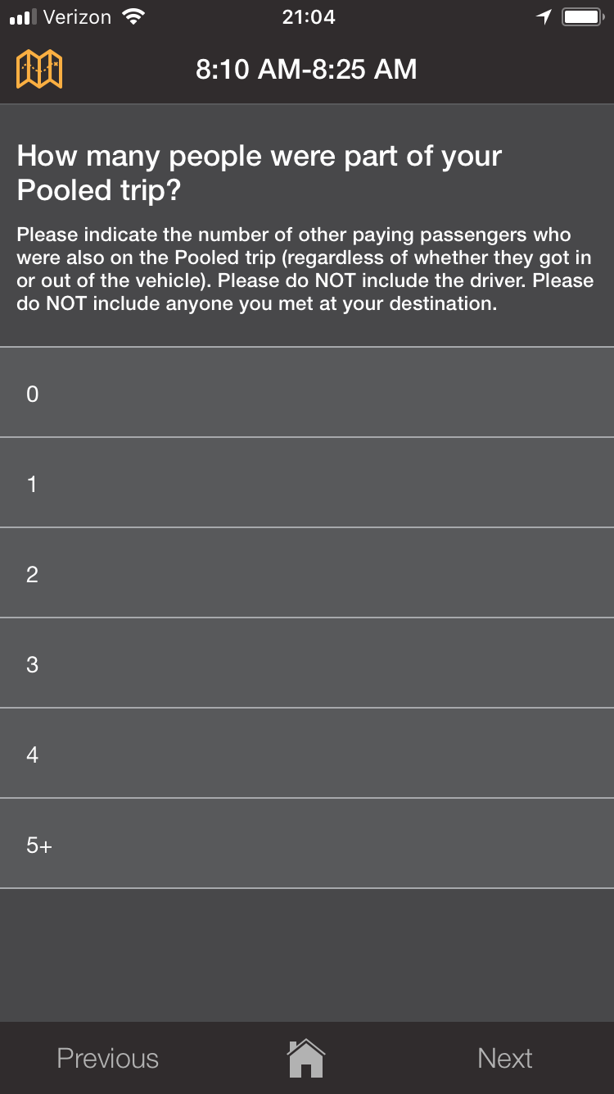
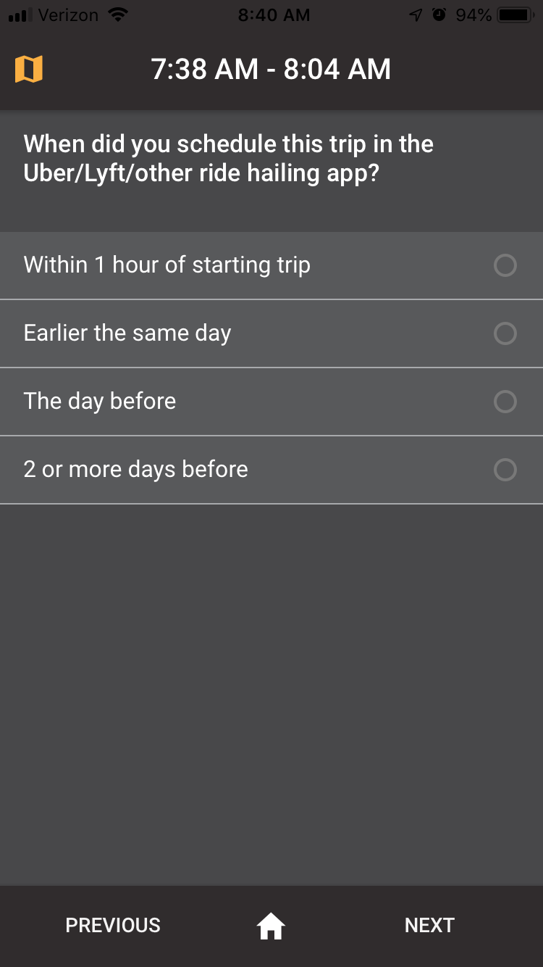
The surveys are optimized to capture TNC trip information
Notes:
Replace the TNC_schedule screenshot with something else, like trip fare.
[update to use new screenshots that include Lyft Shared?]
[Need a list of all TNC-related questions/topics in backup]

Slide 24
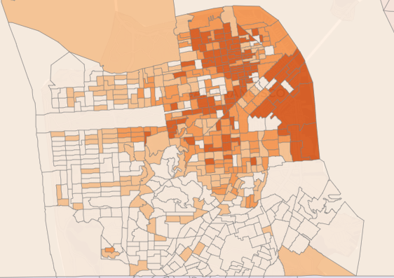
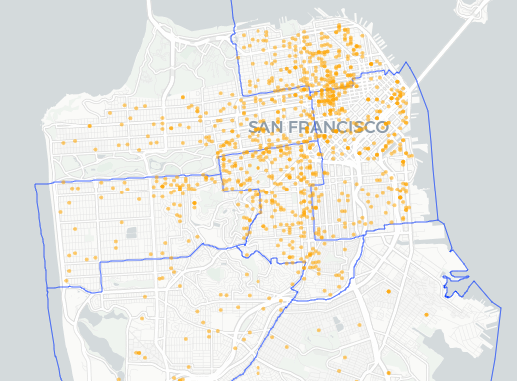
Sampling: What have we achieved in the Bay Area so far? We’ve validated that ABS oversampling for TNC users works
Model where TNC users live → Heavy Oversampling
Obtains more participants who live in those Block Groups
Darker-shaded Block Groups had higher expected TNC use and received higher invitation rates.
As expected, more participants are coming from the oversampled areas.
Notes:
We take ACS data and model which block groups will have residents that are more likely to use TNC? This model is based upon SANDAG HTS data.
We invite more households from those block groups/neighborhoods, increasing participation from those households/persons.
(Next slide shows how well this stratification is working).
We did have troubles with this early on. Response rates were low, very low, but the mailing/recruitment approach was revised and negative external factors seem to be fewer.

Slide 25
ABS oversampling for TNC users is very effective
Scalability/impact depends on the region’s level of TNC use
Sample Region | Sample Strata | % self-described ‘TNC Users’ | TNC mode share | ‘Shared mobility’ mode share (car/bike/scooter)
San Francisco County | Very High TNC | 62% | 7.2% | 1.5%
 | High TNC | 58% | 5.1% | 1.6%
 | Medium TNC | 45% | 3.1% | 0.3%
 | General Population | 47% | 1.9% | 0.3%
 | Subtotal | 57% | 5.5% | 1.3%
8-County Region | Very High TNC | 43% | 2.0% | 2.1%
 | High TNC | 64% | 2.7% | 1.9%
 | Medium TNC | 51% | 1.9% | 0.9%
 | General Population | 31% | 0.7% | 0.4%
 | Subtotal | 45.0% | 1.6% | 1.0%
 | Total | 52.1% | 3.9% | 1.2%
Persons completing survey in 2018*
313
209
97
53
672
47
97
148
181
473
1,145
* Based upon a draft dataset of 1,145 persons who completed the Bay Area TNC study in 2018. All survey figures unweighted.
Notes:
Things to call out:
The TNC mode shares are scaling well with the oversampling. It’s working.
The low TNC mode share in the general population does
The scalability of this approach is essentially constrained by the reality of TNC use in each area.
The SF distribution of High vs Low TNC use (two-thirds of HHs live in a high-TNC area) is the inverse of the Eight-County Region (only 9% lives in a TNC oversample area).
We’re getting a relatively high Percent of people taking TNC trips, compared to the % who are self-described TNC users.
In the San Diego HTS< only ~2% of BGs qualified as Very High TNC, with another 6% of BGs as High TNC.
We’re getting about the right share of people taking TNC trips as say they take TNCs, at least in the high-frequency strata and from high-frequency users. The issue is getting TNC trips from rare users, which is most of the TNC-using population.

Slide 26
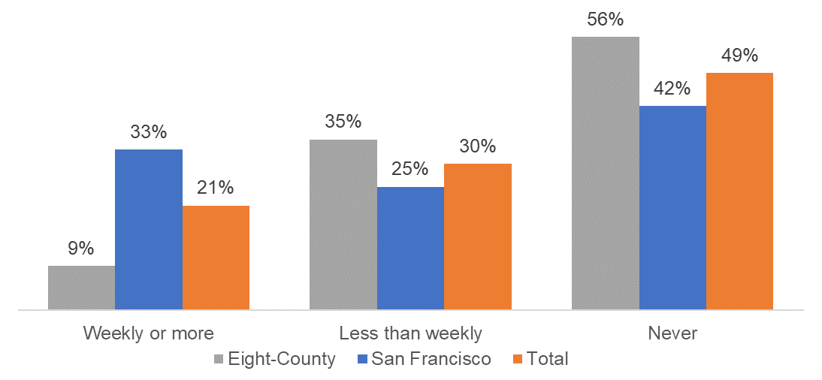
San Francisco’s level of TNC use far outpaces the other counties in the Bay Area, with one-third of adults using TNCs weekly or more
% of adults from the Nine-County Bay Area TNC survey
The Eight-County area shows higher TNC use than San Diego & Sacramento (shown earlier)
* Preliminary results

Slide 27
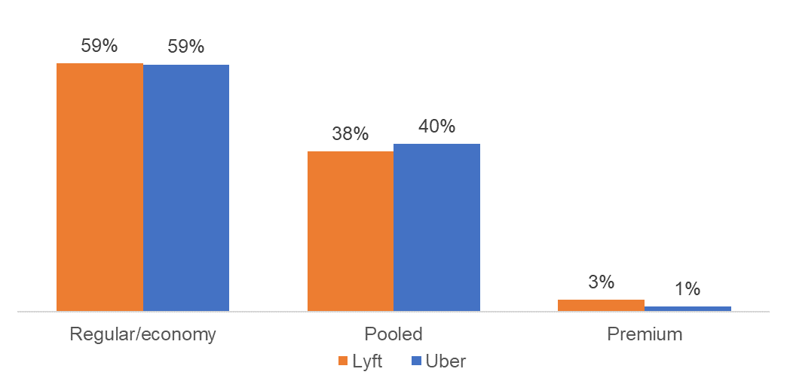
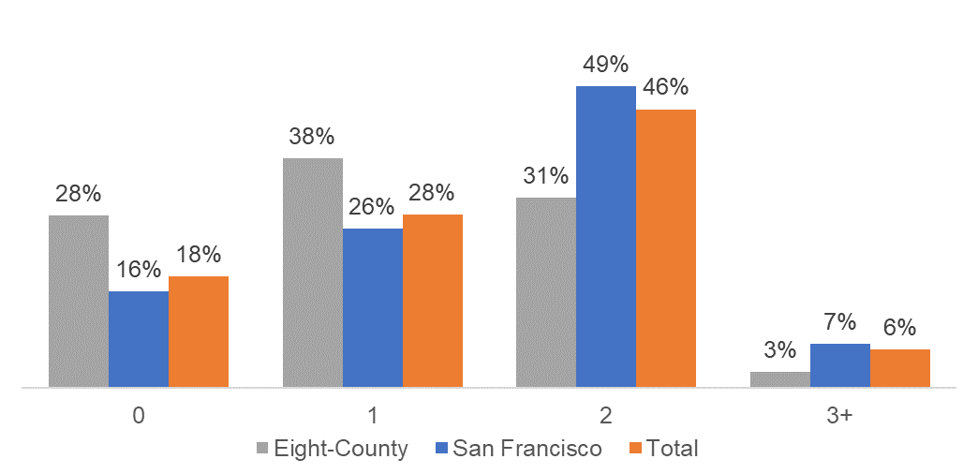
About 40% of TNC trips are pooled trips.
But about 1 in 5 pooled trips are not actually pooled.
For TNC trips: What type of Uber/Lyft did you request?
For Pooled Trips: How many other passengers?
* Preliminary results
Notes:
“According to recent studies, between 43% and 61% of TNC trips substitute for transit, walk, or bike travel or would not have been made at all” (source: https://www.sfcta.org/sites/default/files/2019-05/TNCs_Congestion_Report_181015_Finals.pdf, page 12)

Slide 28
Among main TNC market (under age 45) pooled use is highest among younger groups

Slide 29
Pooled use is highest for incomes below $50,000, and lowest for the highest income group

Slide 30
Pooled use is highest for regular commute trips and “personal business” (errands, shopping)

Slide 31
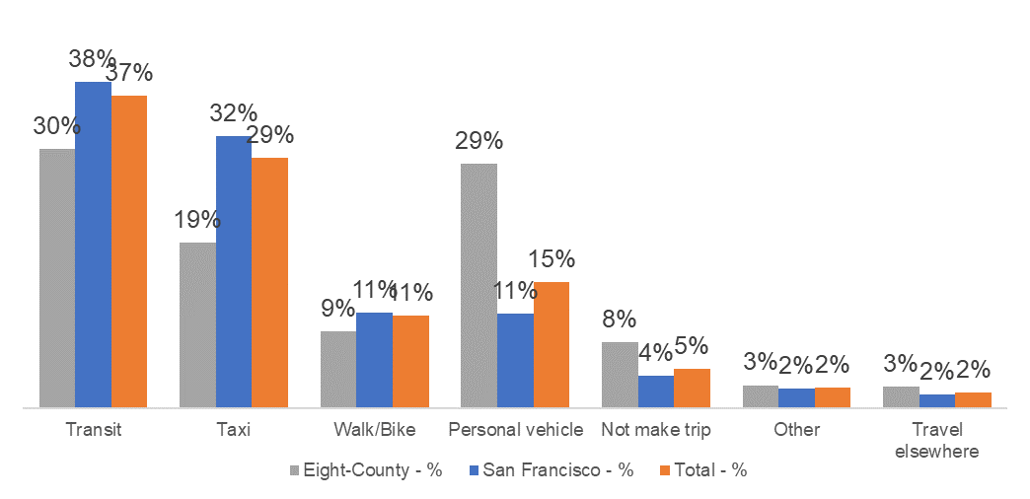
In San Francisco, two-thirds of TNC trips substituted for Taxi/Car trips. Outside San Francisco, 29% would be personal vehicle.
For TNC trips: If Uber/Lyft, did not exist, how would you have made this trip?
* Preliminary results
Notes:
“According to recent studies, between 43% and 61% of TNC trips substitute for transit, walk, or bike travel or would not have been made at all” (source: https://www.sfcta.org/sites/default/files/2019-05/TNCs_Congestion_Report_181015_Finals.pdf, page 12)

Slide 32
Non-car owners most likely to use transit or walk/bike if TNC were not available
For TNC trips: If Uber/Lyft, did not exist, how would you have made this trip?

Slide 33
Younger TNC users more likely to use transit as alternative mode, older users more likely to use taxi or auto
For TNC trips: If Uber/Lyft, did not exist, how would you have made this trip?

